Slide 1
ELECTRICAL SCIENCE-1 (15B11EC111) UNIT-3 Lecture-6

Slide 2
Topics to be Discussed
Maximum power transfer theorem
Numericals
Practice Problems
References

Slide 3
MAXIMUM POWER TRANSFER THEOREM
MODULE: 3

Slide 4
THE THEOREM
THE INTERNAL RESISTANCE OF THE THEVININS EQUIVALENT OF THE GIVEN CIRCUIT IS EQUAL TO THE LOAD RESISTANCE OF THE CIRCUIT THEN MAXIMUM POWER IS TRANSFERRED.
APPLICATIONS:
IT IS USED TO TRANSFER SIGNAL
MAXIMUM POWER TRANSFER IS NOT APPLICABLE FOR POWER LINES

Slide 5
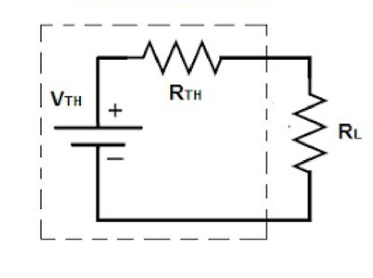
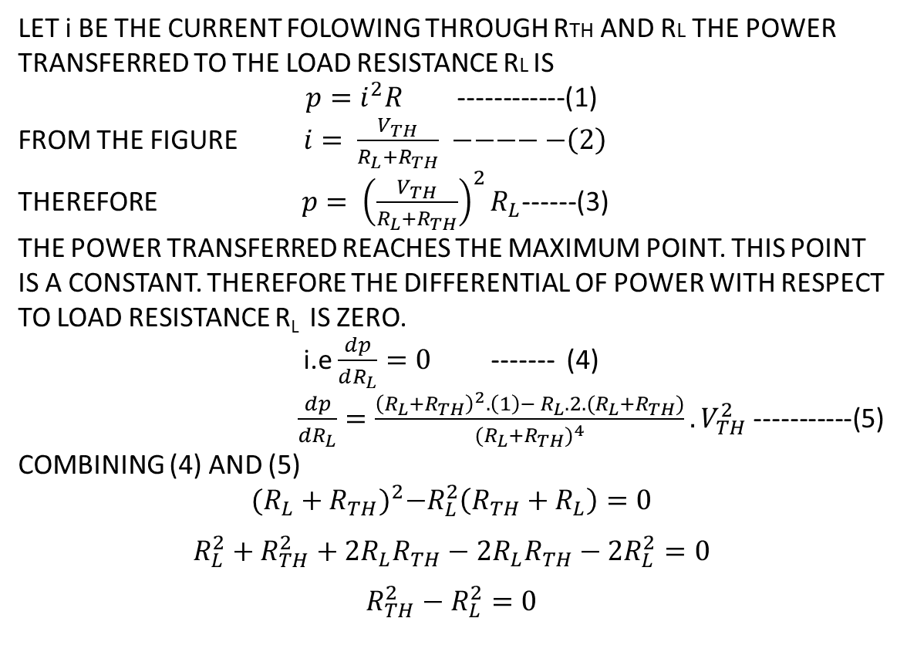
PROOF OF THE THEOREM USING THEVININ’S EQUIVALENT CIRCUIT
LET i BE THE CURRENT FOLOWING THROUGH RTH AND RL THE POWER TRANSFERRED TO THE LOAD RESISTANCE RL IS
$p=i^{2}R$ ------------(1)
FROM THE FIGURE $i= \frac{V_{TH}}{R_{L}+R_{TH}} −−−−−\left(2\right)$
THEREFORE $p= {\left(\frac{V_{TH}}{R_{L}+R_{TH}}\right)}^{2}R_{L}$------(3)
THE POWER TRANSFERRED REACHES THE MAXIMUM POINT. THIS POINT IS A CONSTANT. THEREFORE THE DIFFERENTIAL OF POWER WITH RESPECT TO LOAD RESISTANCE R_{L} IS ZERO.
i.e$\frac{dp}{dR_{L}}=0$ ------- (4)
$\frac{dp}{dR_{L}}=\frac{{\left(R_{L}+R_{TH}\right)}^{2}.\left(1\right)− R_{L}.2.(R_{L}+R_{TH})}{{(R_{L}+R_{TH})}^{4}}.V_{TH}^{2}$ -----------(5)
COMBINING (4) AND (5)
$${(R_{L}+R_{TH})}^{2}−R_{L}^{2}\left(R_{TH}+R_{L}\right)=0$$
$$R_{L}^{2}+R_{TH}^{2}+2R_{L}R_{TH}−2R_{L}R_{TH}−2R_{L}^{2}=0$$
$$R_{TH}^{2}−R_{L}^{2}=0$$
THEVININ’S EQUIVALENT CIRCUIT FOR THE GIVEN CIRCUIT

Slide 6

PROOF CONTD.
$R_{TH}=R_{L}$ --------------(6)
THEREFORE, THE TRANSMITTED POWER WILL BE MAXIMUM IF THE LOAD RESISTANCE OF THE CIRCUIT IS EQUAL TO THE THEVININS RESISTANCE OF THE CIRCUIT.
THE MAXIMUM POWER TRANSFERRED IS
$p_{MAX}=\frac{V_{TH}^{2}R_{TH}}{{(2R_{TH})}^{2}}=\frac{V_{TH}^{2}}{4R_{TH}}$ ---------------(7)

Slide 7
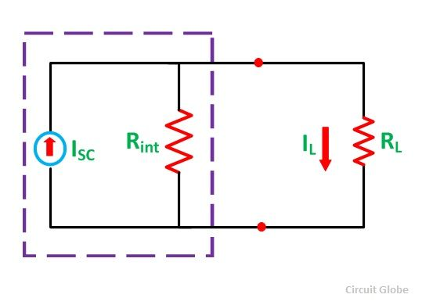
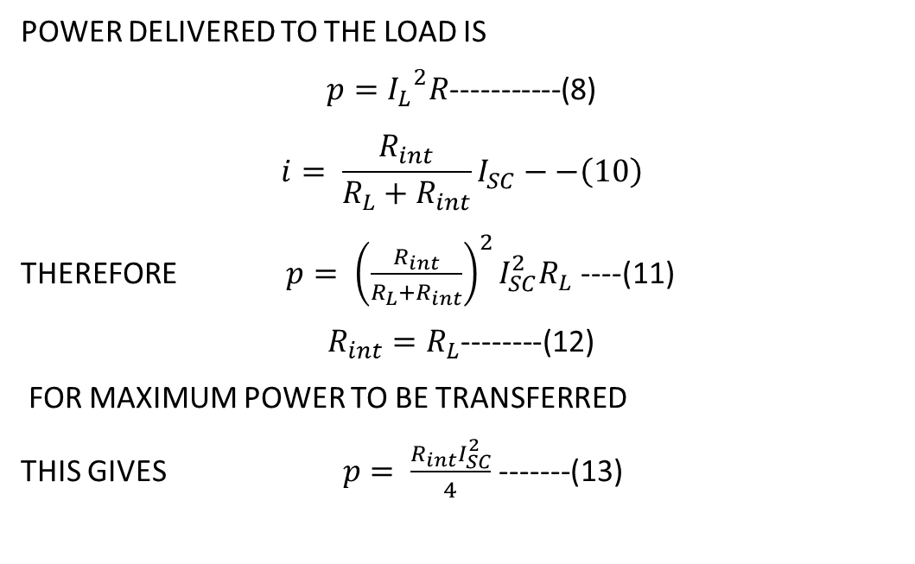
PROOF OF THE THEOREM USING NORTON’S EQUIVALENT CIRCUIT
POWER DELIVERED TO THE LOAD IS
$p={I_{L}}^{2}R$-----------(8)
$$i= \frac{R_{int}}{R_{L}+R_{int}}I_{SC}−−\left(10\right)$$
THEREFORE $p= {\left(\frac{R_{int}}{R_{L}+R_{int}}\right)}^{2}I_{SC}^{2}R_{L}$ ----(11)
$R_{int}=R_{L}$--------(12)
FOR MAXIMUM POWER TO BE TRANSFERRED
THIS GIVES $p= \frac{R_{int}I_{SC}^{2}}{4}$ -------(13)
NORTON’S EQUIVALENT CIRCUIT
FOR THE GIVEN CIRCUIT

Slide 8
EXAMPLE 1 INDEPENDENT SOURCE
FIND RL THAT WILL RESULT IN MAXIMUM POWER TRANSFER FOR THE GIVEN THE CIRCUIT. ALSO DETERMINE THE MAXIMUM POWER.

Slide 9
SOLUTION
THEVININ’S EQUIVALENT CIRCUIT OF THE GIVEN CIRCUIT
MAXIMUM POWER IS TRANSFERRED WHEN Rt = RL

Slide 10
EXAMPLE 2 DEPENDENT SOURCE
FIND RL AND MAXIMUM POWER DELIVERED TO THE LOAD OF THE CIRCUIT.

Slide 11
SOLUTION
OPEN CIRCUIT VOLTAGE OF THE GIVEN CIRCUIT

Slide 12
SOLUTION CONTINUED..
SHORT CIRCUIT CURRENT FOR THE GIVEN CIRCUIT

Slide 13
SOLUTION CONTINUED..
EQUVALENT CIRCUIT OF THE GIVEN CIRCUIT

Slide 14
References
R.C. Dorf and James A. Svoboda, “Introduction to Electric Circuits”, 9th ed, John Wiley & Sons, 2013.
D.C. Kulshreshtha, Basic Electrical Engineering, Revised 1st ed, Tata Mc Graw Hill, 2017.
V. K.Mehta, Rohit Mehta, Basic Electrical Engineering, 6th ed, S. Chand Publishing, 2012.

